Slide 1

LAX Recycling and Source Reduction Program

Slide 2
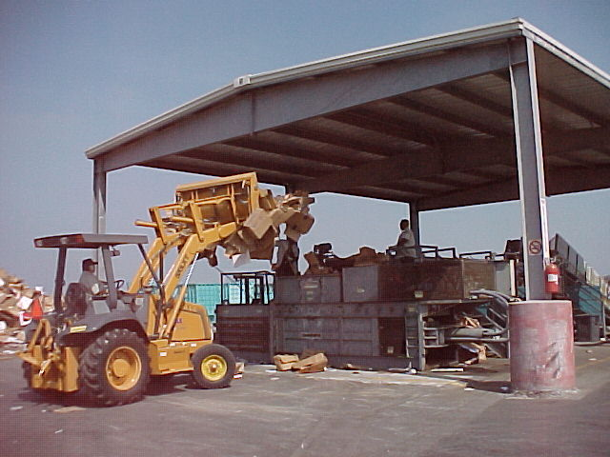
LAX Recycling Program
Established in 1992 as a result of California Integrated Waste Management Act (AB 939).
Act required 50% diversion by the year 2000.
Mayor Villaraigosa established goal of 70% rate by 2020 and vowed to make LAX the “greenest” airport in the nation.

Slide 3
Program Components
In-house collection of recyclable materials generated by LAWA and from common-use recycling containers and bins in airport terminals and airfield areas.
Collection of materials from airlines and tenants through individual agreements at no cost to participants.
Airlines’ and tenants’ own recycling programs and reporting of data to LAWA.
Source reduction through the purchase of recycled products and reuse of materials.

Slide 4
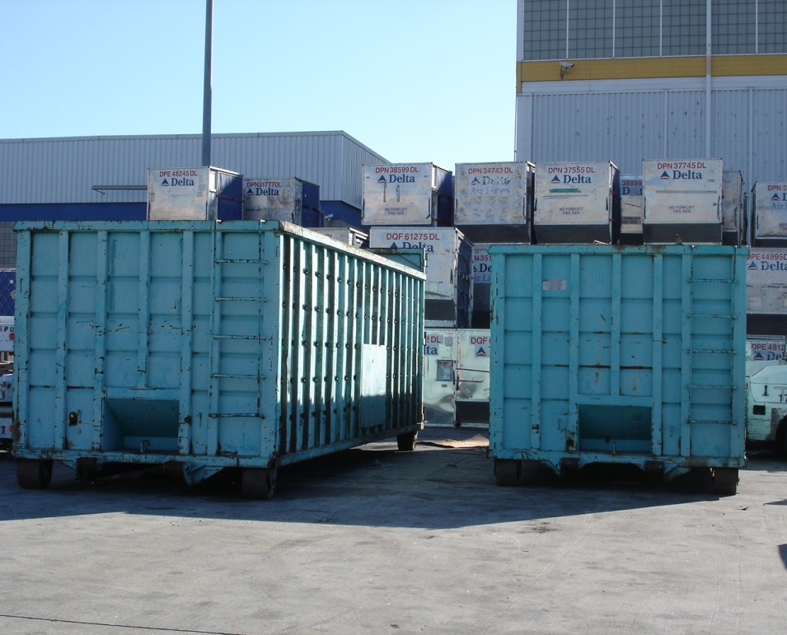
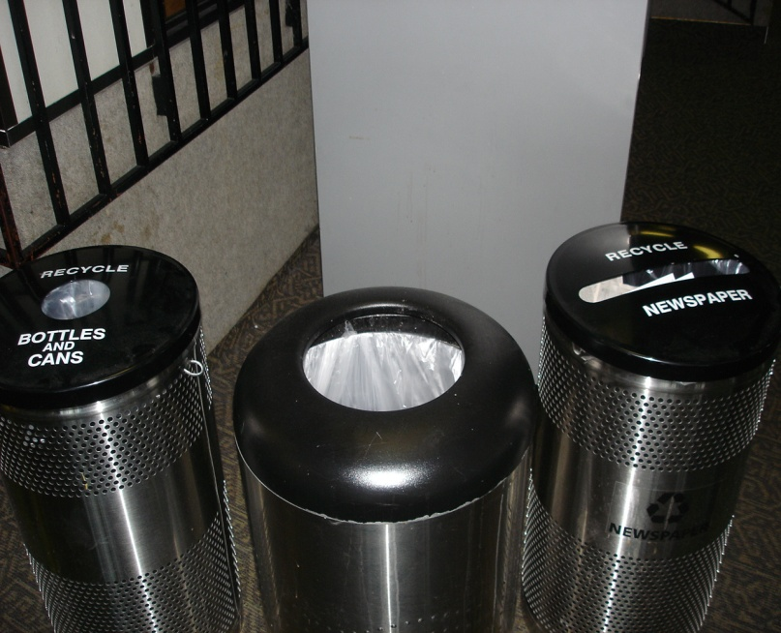
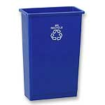
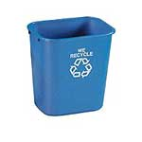
LAX Recycling Program makes it easy for airport employees and the traveling public to recycle by providing convenient recycling bins in offices, terminals, and on the airfield.

Slide 5
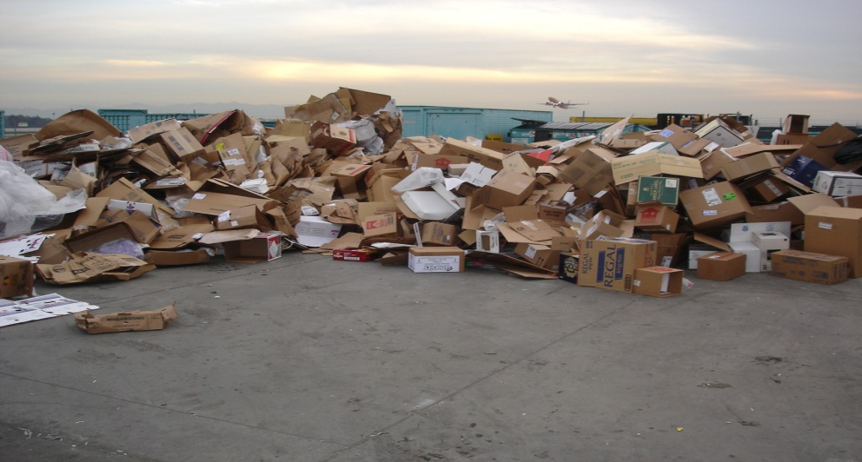
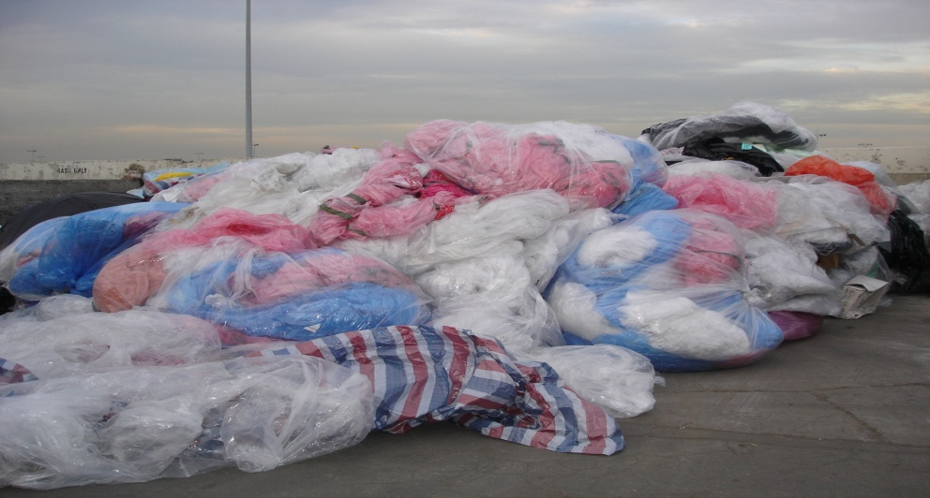
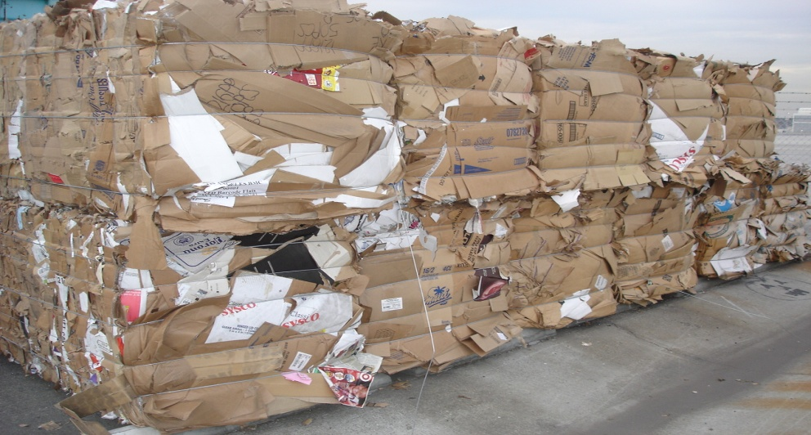
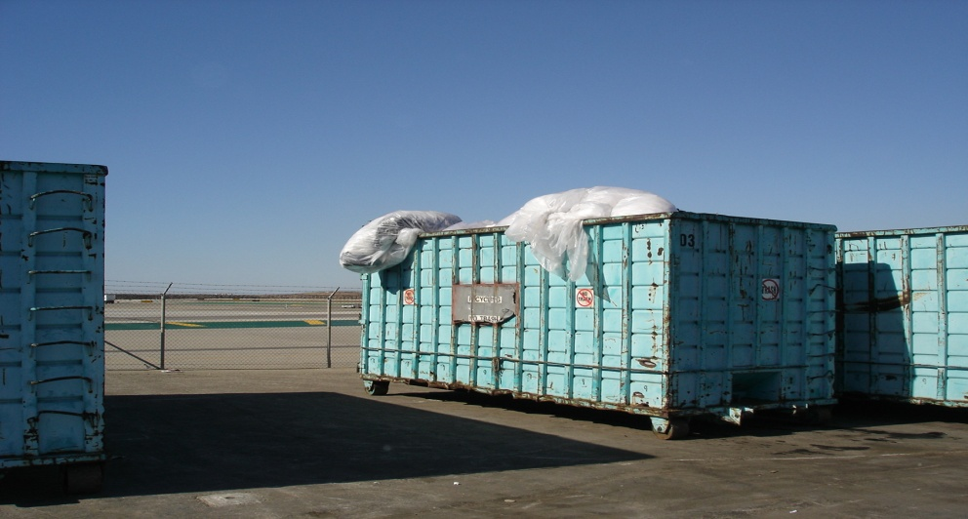
Materials are collected and brought to the transfer facility, sorted, and placed in larger containers or bailed, then sent to various vendors for further processing.

Slide 6
Materials Recycled - 2010
8,066 tons of paper and cardboard
765 tons of plastic including beverage containers
14 tons of grease rendering
2,449 tons of wood and wood pallets
562 tons of metal and aluminum beverage containers
340 tons of green waste
76 tons of tires
11 tons of glass
7,298 tons of construction debris
617 tons of miscellaneous/mixed materials
20,198 tons total

Slide 7
Green waste to compost program - grass clippings and tree trimmings from landscape operations are recycled into compost and mulch.
Asphalt recycling - ground asphalt from pavement profiling operations is recycled and used as Processed Miscellaneous Base (PMB) in pavement reconstruction projects.
Tire recycling – Tires from LAWA vehicle maintenance operations are ground up and used in paving materials.
Rechargeable battery program – LAWA participates in a City program to collect rechargeable batteries.
Waste oil recycling – waste oil from fleet maintenance operations is recycled.
Food donation program– 4,164 pounds of consumable food were donated to homeless shelters in 200.7

Slide 8
Airline and Tenant Recycling
In 2008, airlines and tenants reported over 8,551 tons in source reduction and recycled material through their own programs – approximately 39% of the total program.

Slide 9
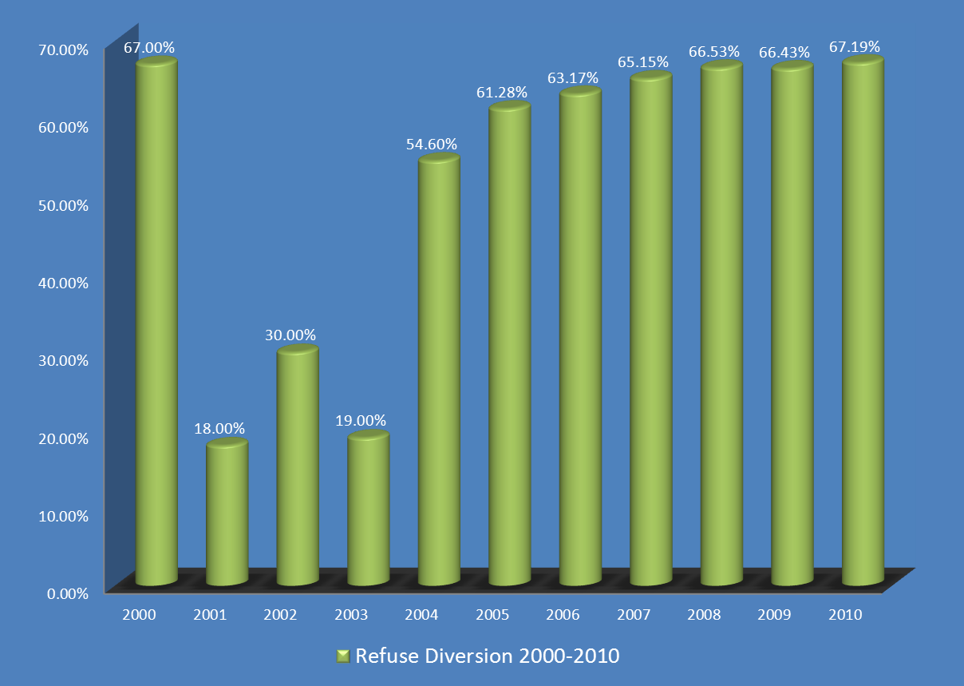
LAX Recycling Rates
*Events of 9/11/2001 caused a drop in tenant reporting and recycling activity during the period 2001-2003

Slide 10
Waste Characterization
1 pound of waste generated by each passenger arriving and departing.
2.8 pounds of waste generated by each ton of cargo.
71% of waste stream is handled by tenants who control their own disposal contracts.
Remaining 29% is controlled, but not necessarily generated by LAWA.
Independent audits have validated this data.

Slide 11
Waste Characterization Categories
Administrative
Cargo
In-flight wastes
Maintenance
Terminals
Restaurant/cafeteria
Other wastes, including construction debris

Slide 12
New Recycling Projects
New advertising “amenity units” incorporating recycling collection into the unit. Part of LAWA’s new advertising concession program.

Slide 14
New Recycling Projects cont.
Food Waste and Coffee grinds recycling – LAWA plans to begin recycling food waste, coffee grinds and filters into compost.
Expand cooking oil and grease recycling. 28,612 lbs. were recycled in 2010. Exploring the feasibility of airport-wide collection program.
Mandatory recycling in airport concession contracts – currently voluntary.

Slide 15
QUESTIONS?
LAX Recycling Program provided by:
  LAX Construction & Maintenance Services
  7411 World Way West
  Los Angeles, CA 90045
  (424) 646-7900 (310) 646-9416 Fax
For More Information Call:
  Tom Mchugh, Airport Superintendent, Ext. 6-7843
  tmchugh@lawa.org
  David Takemoto, Airport Supervisor II, Ext. 6-7984
  dtakemoto@lawa.org
  Sheriece Sewell, Sr. Clerk Typist, Ext. 6-7847
  srusseau@lawa.org

